Slide 1
ML based structure search
Malthe Kjær Bisbo
6-11-2018

Slide 2
Simple problem
x1
x2

Slide 3
Simple problem
Training data:
1)
x1
x2

Slide 4
Simple problem
Training data:
1)
2)
x1
x2

Slide 5
Simple problem
Training data:
1)
2)
3)
x1
x2

Slide 6
Simple problem
Training data:
1)
2)
3)
4)
x1
x2

Slide 7
Simple problem
Training data:
1)
2)
3)
4)
5)
x1
x2

Slide 8
Simple problem
Training data:
1)
2)
3)
4)
5)
Global minimum

Slide 9




Method
Initial structures
Train
model
Consult DFT
Search ML potential

Slide 10
General method
1)
2)
3)
Initial structures
Train
model
Consult DFT
Search ML potential

Slide 11
General method
1)
2)
3)
Initial structures
Train
model
Consult DFT
Search ML potential

Slide 12
General method
1)
2)
3)
Initial structures
Train
model
x
x
x
Consult DFT
Search ML potential
x
x
x
x

Slide 13
General method
1)
2)
3)
Initial structures
Train
model
x
x
x
Consult DFT
Search ML potential
x
x
x

Slide 14
General method
1)
2)
3)
Initial structures
Train
model
x
x
x
Consult DFT
Search ML potential
x
x
x

Slide 15
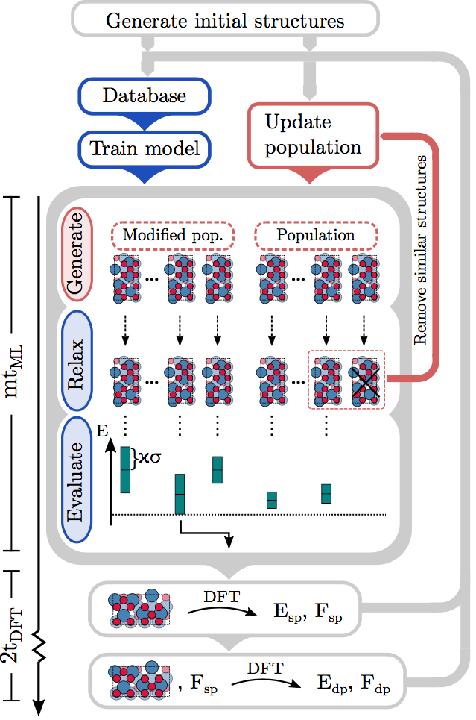
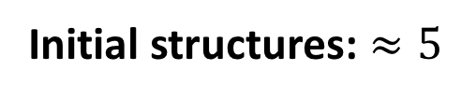
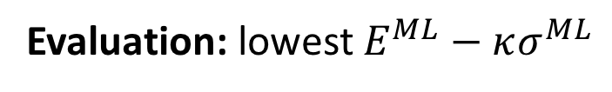
Method
Initial structures: $≈5$
To enter population: 1. Dissimilar
2. Lower energy
Evaluation: lowest $E^{ML}−κσ^{ML}$

Slide 16

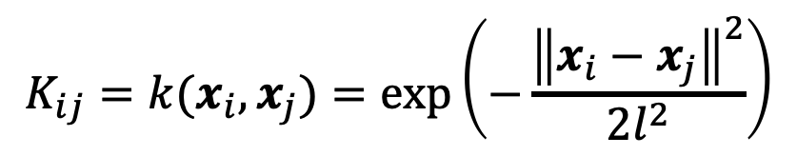
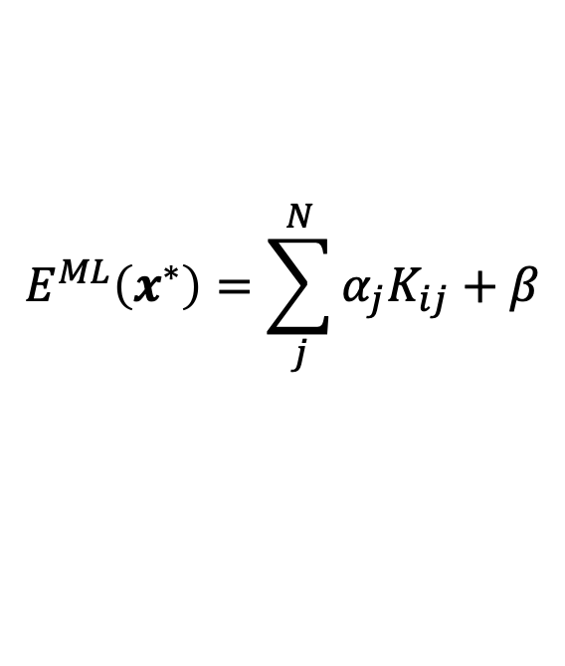
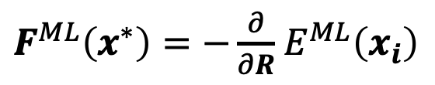

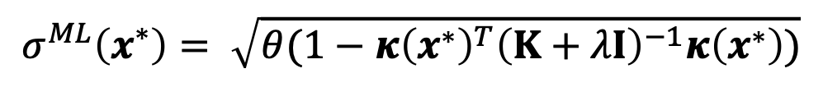

Gaussian process regression
Prediction:
Training:
$$E^{ML}\left(x^{∗}\right)=\sum_{j}^{N}{α_{j}K_{ij}+β}$$
$$α={\left(K+λI\right)}^{−1}E$$
$F^{ML}\left(x^{∗}\right)=−\frac{∂}{∂R}$ $E^{ML}\left(x_{i}\right)$
$$σ^{ML}\left(x^{∗}\right)= \sqrt{θ(1−{κ\left(x^{∗}\right)}^{T}{\left(K+λI\right)}^{−1}κ\left(x^{∗}\right))}$$
Kernel:
$$K_{ij}=k(x_{i},x_{j})=\exp\left(−\frac{{\left\|x_{i}−x_{j}\right\|}^{2}}{2l^{2}}\right)$$
$$κ\left(x^{∗}\right)=k(x^{∗}, X)$$

Slide 17
Gaussian process regression
Prediction:
Training:
$$E^{ML}\left(x^{∗}\right)=\sum_{j}^{N}{α_{j}K_{ij}+β}$$
$$α={\left(K+λI\right)}^{−1}E$$
$F^{ML}\left(x^{∗}\right)=−\frac{∂}{∂R}$ $E^{ML}\left(x_{i}\right)$
$$σ^{ML}\left(x^{∗}\right)= \sqrt{θ(1−{κ\left(x^{∗}\right)}^{T}{\left(K+λI\right)}^{−1}κ\left(x^{∗}\right))}$$
Kernel:
$$K_{ij}=k(x_{i},x_{j})=\exp\left(−\frac{{\left\|x_{i}−x_{j}\right\|}^{2}}{2l^{2}}\right)$$
$$κ\left(x^{∗}\right)=k(x^{∗}, X)$$

Slide 18
Gaussian process regression
Prediction:
Training:
$$E^{ML}\left(x^{∗}\right)=\sum_{j}^{N}{α_{j}K_{ij}+β}$$
$$α={\left(K+λI\right)}^{−1}E$$
$F^{ML}\left(x^{∗}\right)=−\frac{∂}{∂R}$ $E^{ML}\left(x_{i}\right)$
$$σ^{ML}\left(x^{∗}\right)= \sqrt{θ(1−{κ\left(x^{∗}\right)}^{T}{\left(K+λI\right)}^{−1}κ\left(x^{∗}\right))}$$
Kernel:
$$K_{ij}=k(x_{i},x_{j})=\exp\left(−\frac{{\left\|x_{i}−x_{j}\right\|}^{2}}{2l^{2}}\right)$$
$$κ\left(x^{∗}\right)=k(x^{∗}, X)$$

Slide 19
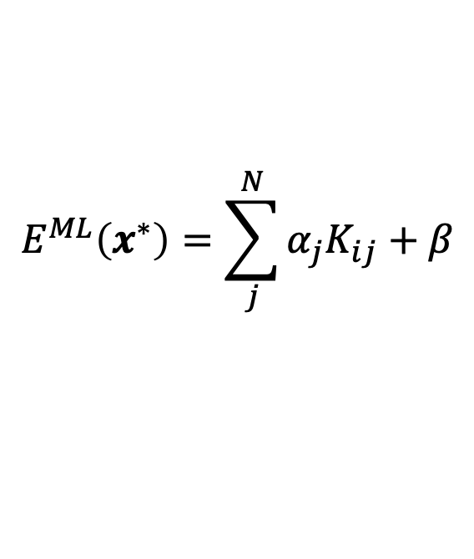
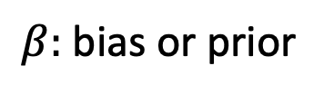
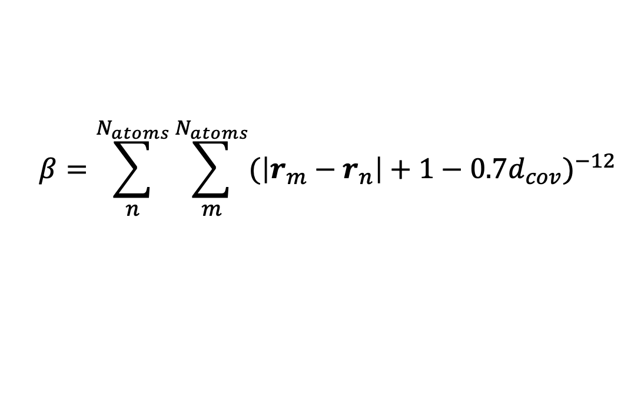
Delta Learning
Recall:
$$E^{ML}\left(x^{∗}\right)=\sum_{j}^{N}{α_{j}K_{ij}+β}$$
$β:$ bias or prior
Prior knowlegde: Atoms repel each other
Use:
$$β=\sum_{n}^{N_{atoms}}{\sum_{m}^{N_{atoms}}{{(\left|r_{m}−r_{n}\right|+1−{0.7d}_{cov})}^{−12}}}$$

Slide 20
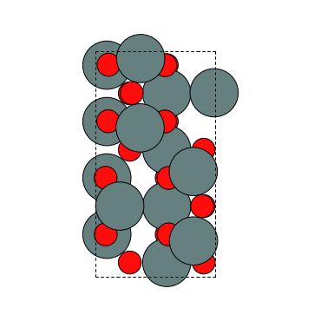
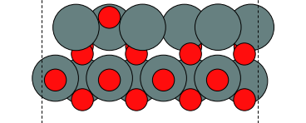



Sn₃O₃
Relax with:
$$E^{ML}$$
Top:
Side:
Evaluate with:
$$f=E^{ML}−κσ^{ML}$$
Varying kernel width
Varying $κ$
Varying both

Slide 21



Sn₃O₃ - PCA
$$κ=0.5$$
$$κ=2$$
$$κ=8$$
Iteration:
Energy:

Slide 22
Sn₃O₃
The convergence to the
global minimum is not
perfect!

Slide 23
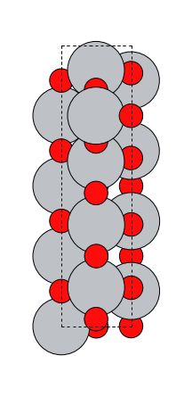
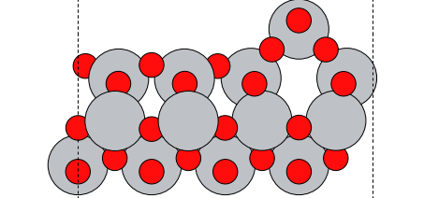

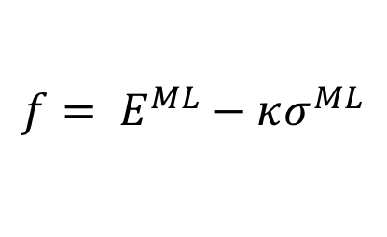
TiO -3 layer
dmax=0.2
Relax with:
$$f= E^{ML}−κσ^{ML}$$
Reasons for not reaching 100% success:
GM predicted to be unfaverable.
New candidates close to minimum not produced my mutations.
Evaluate with:
$$f=E^{ML}−κσ^{ML}$$

Slide 24
TiO -3 layer
Energy
Need better new candidates.
Search iteration

Slide 25
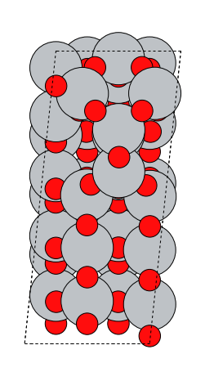
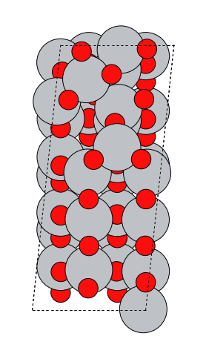
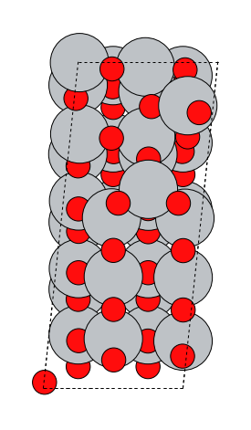
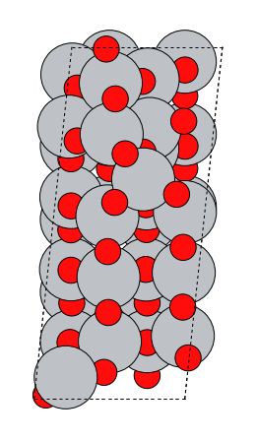
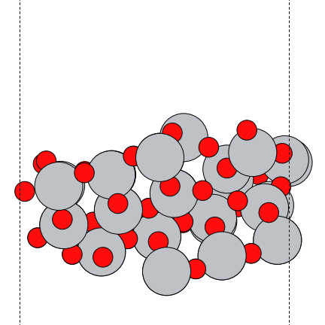
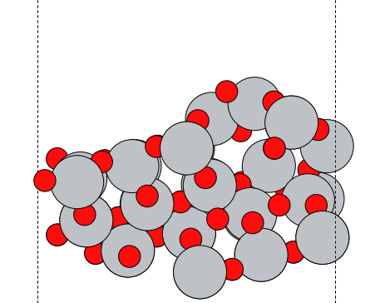
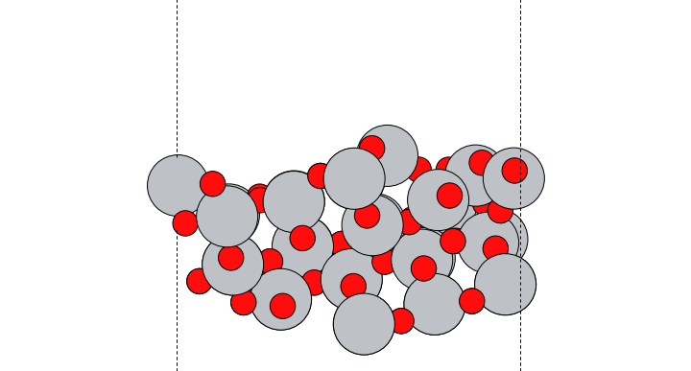
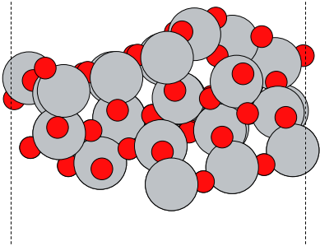




TiO2 – double step
Found twice
$$E_{0}=−764.27$$
$$E_{1}=−763.71$$
$$E_{2}=−763.58$$
$$E_{3}=−763.33$$

Slide 26
TiO2 – double step

Slide 27
TiO2 – double step
Kernel width=30
Kernel width=10
Kernel width=3

Slide 28
TiO2 – double step

Slide 29
TiO2 – double step
d_dilute=0.1
d_dilute=0.3
d_dilute=0.5

Slide 30
TiO2 – double step
Kernel width prior = 30
Kernel width 2 = 3

Slide 31
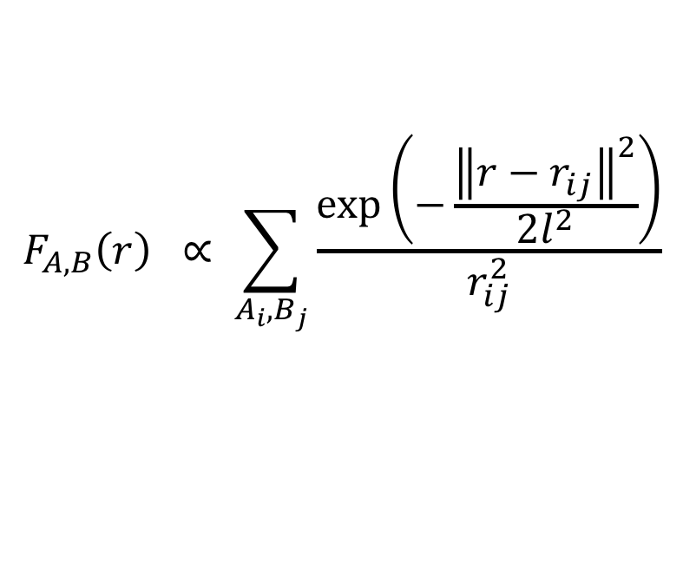
Descriptors
Example 2 – Oganov and Valle
$$F_{A,B}\left(r\right) ∝ \sum_{A_{i},B_{j}}{\frac{\exp\left(−\frac{{\left\|r−r_{ij}\right\|}^{2}}{2l^{2}}\right)}{r_{ij}^{2}}}$$

Slide 32

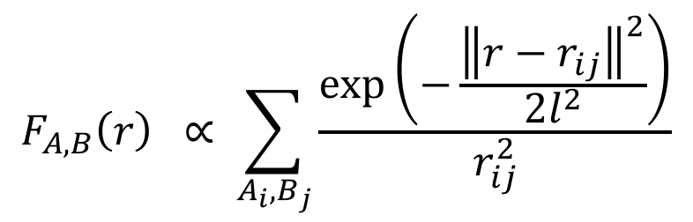
Descriptors
Example 2 – Oganov and Valle
$$F_{A,B}\left(r\right) ∝ \sum_{A_{i},B_{j}}{\frac{\exp\left(−\frac{{\left\|r−r_{ij}\right\|}^{2}}{2l^{2}}\right)}{r_{ij}^{2}}}$$
Sum gaussians
$$r_{12}$$

Slide 33

Descriptors
Example 2 – Oganov and Valle
$$F_{A,B}\left(r\right) ∝ \sum_{A_{i},B_{j}}{\frac{\exp\left(−\frac{{\left\|r−r_{ij}\right\|}^{2}}{2l^{2}}\right)}{r_{ij}^{2}}}$$
Sum gaussians
$$r_{13}$$
$$r_{12}$$

Slide 34

Descriptors
Example 2 – Oganov and Valle
$$F_{A,B}\left(r\right) ∝ \sum_{A_{i},B_{j}}{\frac{\exp\left(−\frac{{\left\|r−r_{ij}\right\|}^{2}}{2l^{2}}\right)}{r_{ij}^{2}}}$$
Sum gaussians
$$r_{13}$$
$$r_{12}$$
$$r_{23}$$

Slide 35
Descriptors
Example 2 – Oganov and Valle
$$F_{A,B}\left(r\right) ∝ \sum_{A_{i},B_{j}}{\frac{\exp\left(−\frac{{\left\|r−r_{ij}\right\|}^{2}}{2l^{2}}\right)}{r_{ij}^{2}}}$$
Sum gaussians

Slide 36

Descriptors
Example 2 – Oganov and Valle
$$F_{A,B}\left(r\right) ∝ \sum_{A_{i},B_{j}}{\frac{\exp\left(−\frac{{\left\|r−r_{ij}\right\|}^{2}}{2l^{2}}\right)}{r_{ij}^{2}}}$$
Final feature
Sum gaussians
+ scale
Permutation

